Slide 1


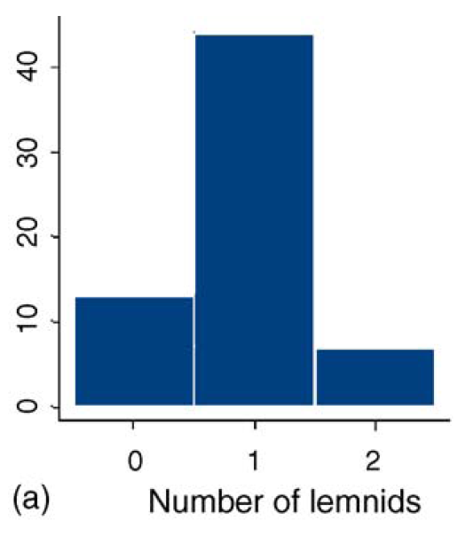
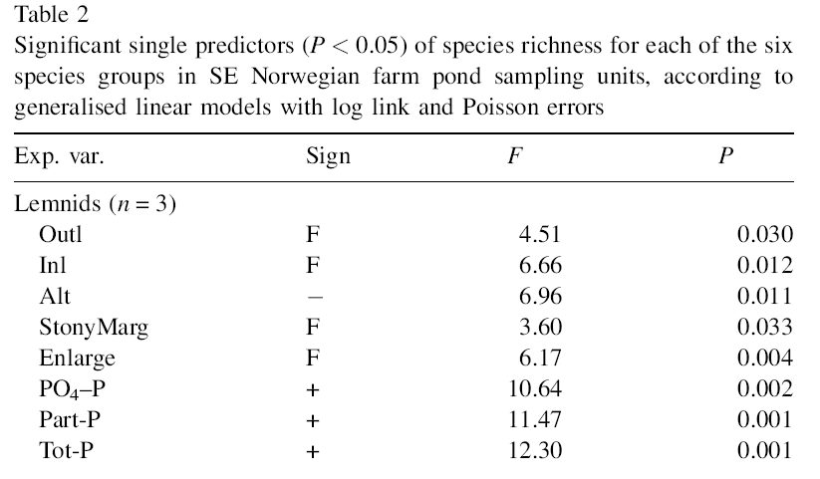
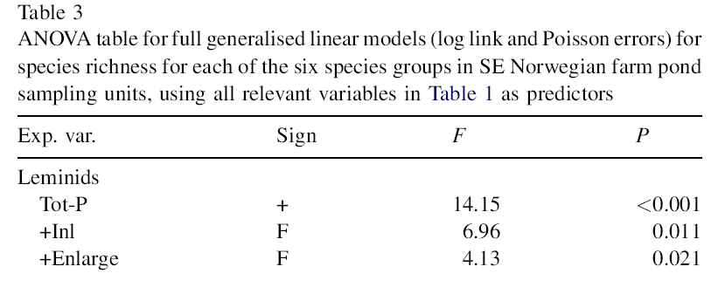

+ many other spp.

Slide 2


N = 23 river wetlands
+ many other spp.

Slide 3

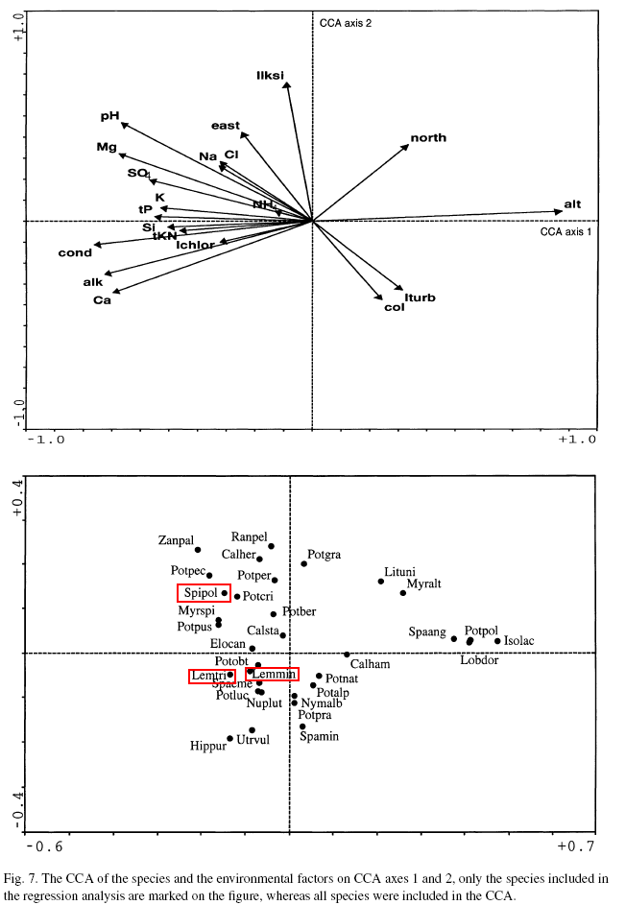


N = 574 lakes
+ 29 other common species

Slide 4


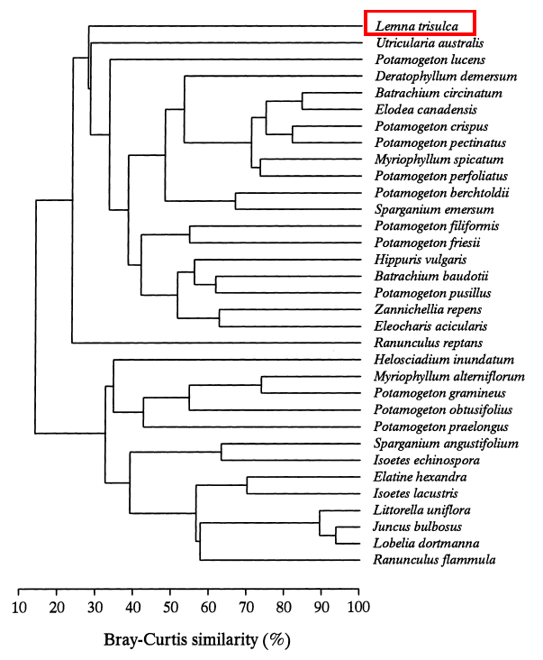
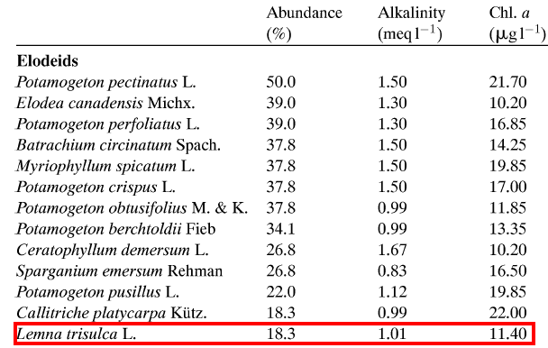
N = 82 lakes
+ many more less common spp.

Slide 5



N = 40 reaches
+ 8 other less common spp.

Slide 6


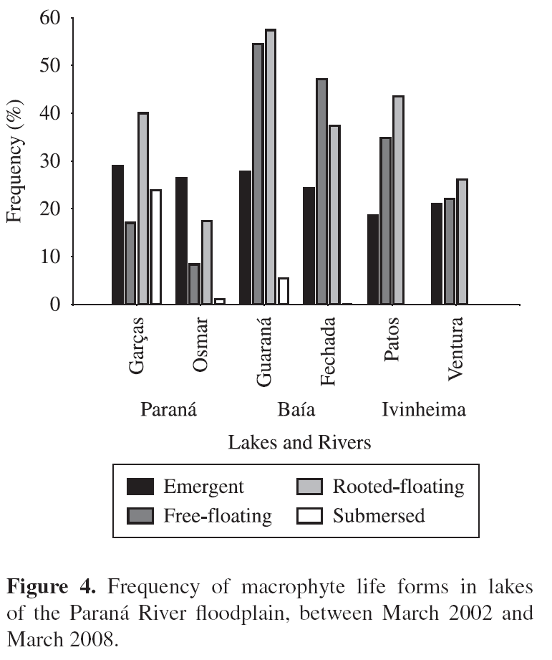
Their measure “frequency” is unclear…

